Slide 1
Team T.chaitanya M.Soniya B.naveen Kumar Reddy N.hemanth M .bharath K.gurucharan

Slide 2

competitive Analysis Of Leading Travel Aggregators

Slide 3
project flow
Data preparation
Data visualization
Dash board
Story
Report
performance testing
Web integration

Slide 4
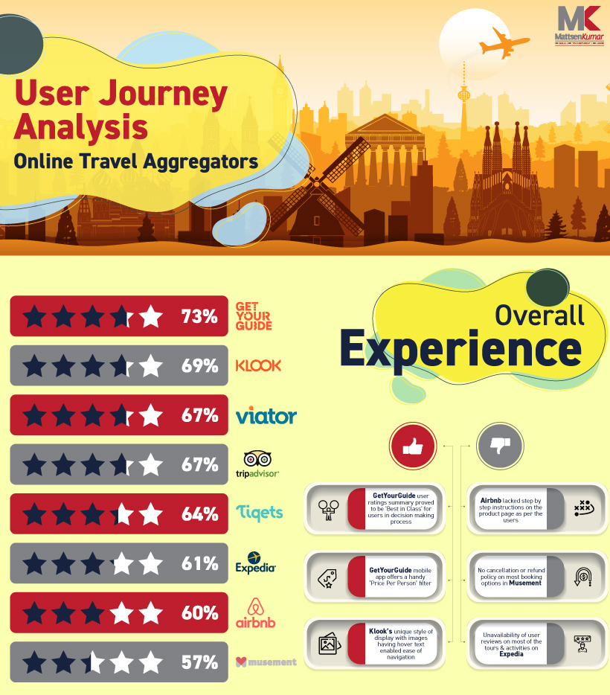
Data visualizations
User Journey Analysis of traverlers who relied on varied Online Travel Aggregators reveals numerous secrets to quality customer experience. Amsterdam, Bangkok and New York were the top travel destinations and OTAs like Expedia, Airbnb, TripAdvisor, KLOOK and Tickets were used to book tickets.
The user journey analysis highlights and rates the varied OTAs involved on the basis of content, pricing, navigation and overall experience. The insight highlights the best and worst of these OTAs and assists a traveler in finding the best travel aggregator.

Slide 5
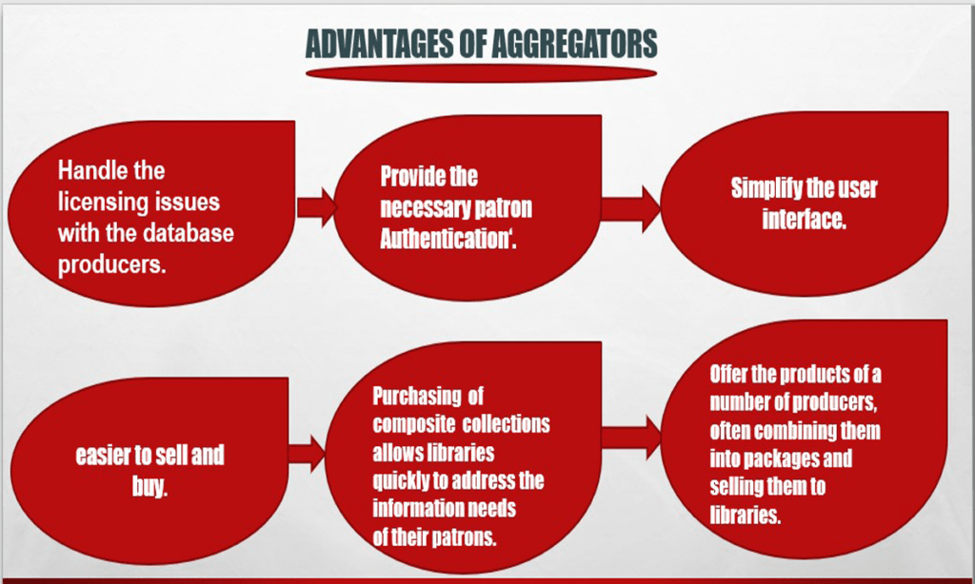
Introduction to Competitive Analysis of Leading Travel Aggregators
Travel aggregators are online platforms that consolidate information from multiple sources to provide users with the best travel deals and options.
The leading travel aggregators in the market include Expedia, Booking.com, and Kayak.
This analysis aims to compare these leading travel aggregators based on their features, user experience, and market share.
Notes:
Image source: https://limbd.org/aggregators-types-of-aggregators-advantages-of-aggregators-disadvantages-of-aggregators-importance-of-aggregators/

Slide 6
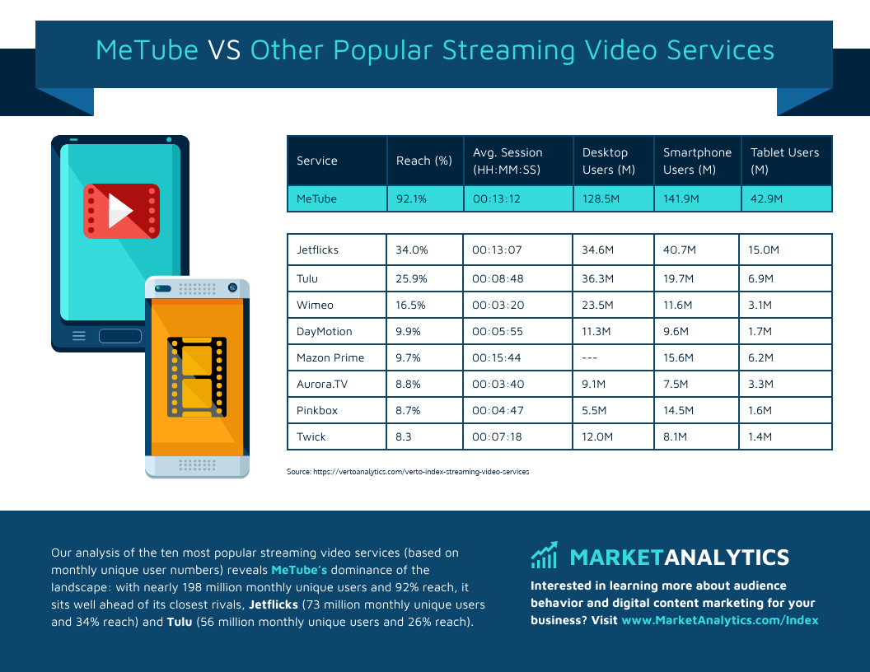
Features and Services Comparison
Expedia offers a comprehensive range of services, including flight and hotel bookings, vacation packages, car rentals, and activities.
Booking.com focuses primarily on hotel bookings but also offers flight and car rental options, with a strong emphasis on customer reviews and ratings.
Kayak provides users with a powerful search engine that compares prices across multiple travel sites for flights, hotels, car rentals, and more.
Notes:
Image source: https://www.pinterest.co.uk/pin/customer-video-services-comparison-infographic-template--667940188475272335/

Slide 7

User Experience Evaluation
Expedia provides a user-friendly interface with a simple booking process, extensive filters, and options for advanced search.
Booking.com offers a seamless user experience with a visually appealing interface, clear pricing information, and easy navigation.
Kayak stands out with its clean and intuitive design, personalized recommendations, and real-time updates on price changes.
Notes:
Image source: https://www.pinterest.com.mx/pin/ux-6d-process-en-2023--239183430201181854/

Slide 8
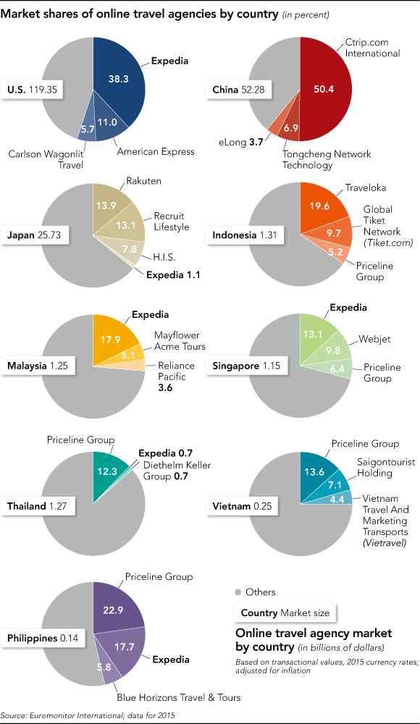
Market Share Analysis
Expedia holds a significant market share with a strong presence in North America and Europe, offering a wide range of travel services.
Booking.com is a dominant player in the hotel booking market with a global reach and a strong focus on customer reviews and ratings.
Kayak has gained popularity as a leading metasearch engine, attracting users with its comprehensive search capabilities and price comparison features.
Notes:
Image source: https://frontera.net/news/asia/expedia-aims-to-double-market-share-in-apac-region-with-mix-of-tech-and-takeovers/

Slide 9

Strengths and Weaknesses
Expedia's strength lies in its extensive range of services and a global network of partners, but it can sometimes be overwhelming for users due to its vast options.
Booking.com excels in user reviews and ratings, ensuring transparency and trust, but its focus on hotels limits its scope compared to other aggregators.
Kayak's strength lies in its powerful search engine and price comparison capabilities, but it may lack the personalized touch provided by other aggregators.
Notes:
Image source: https://quotefancy.com/quote/1636408/Sophia-Amoruso-True-success-lies-in-knowing-your-weaknesses-and-playing-to-your-strengths

Slide 10
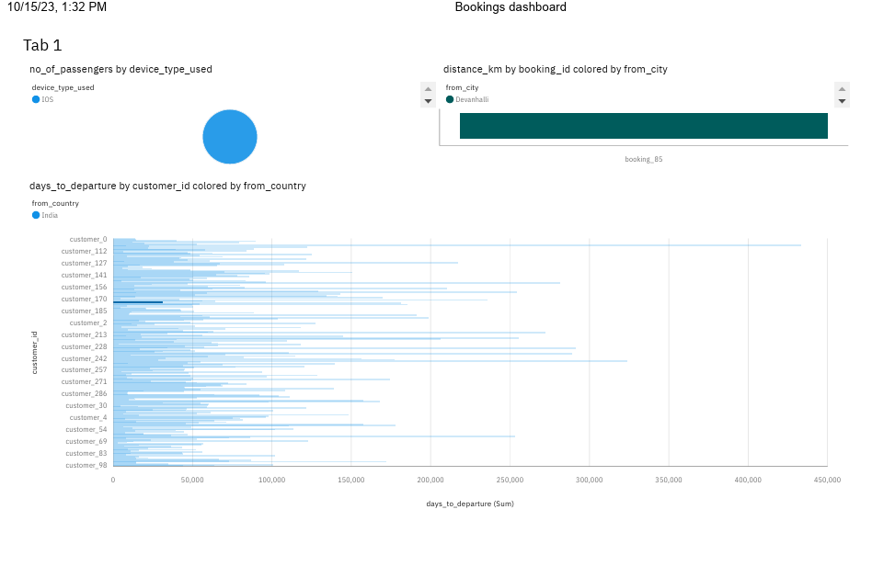
DASHBORD

Slide 11
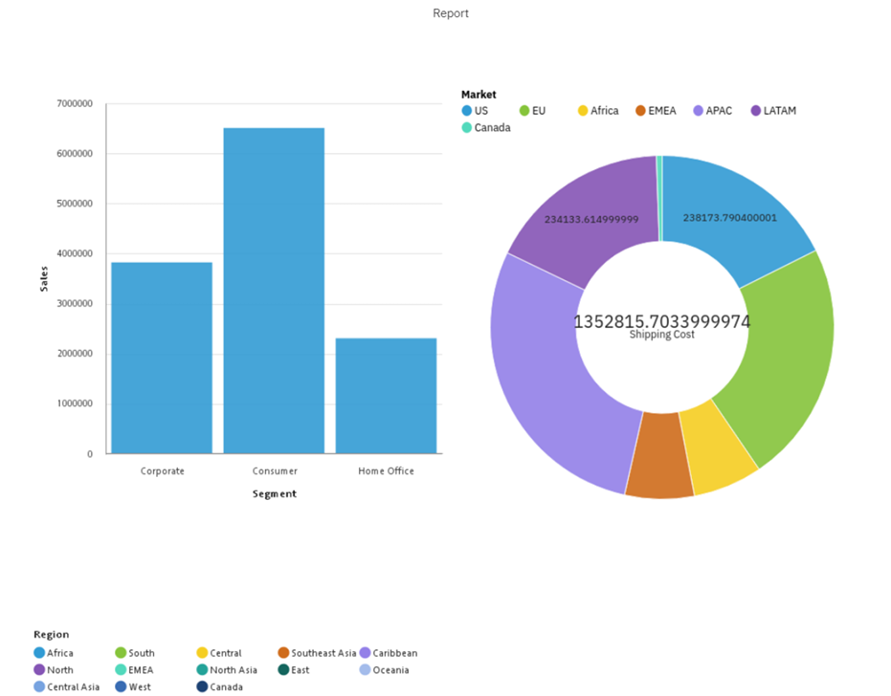
REPORT

Slide 12
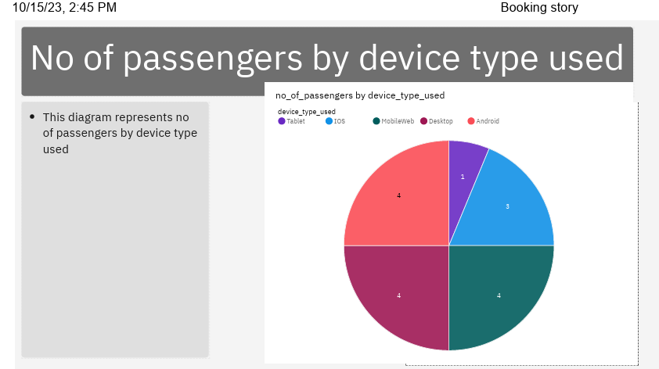
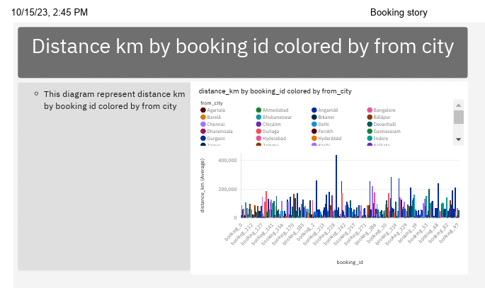
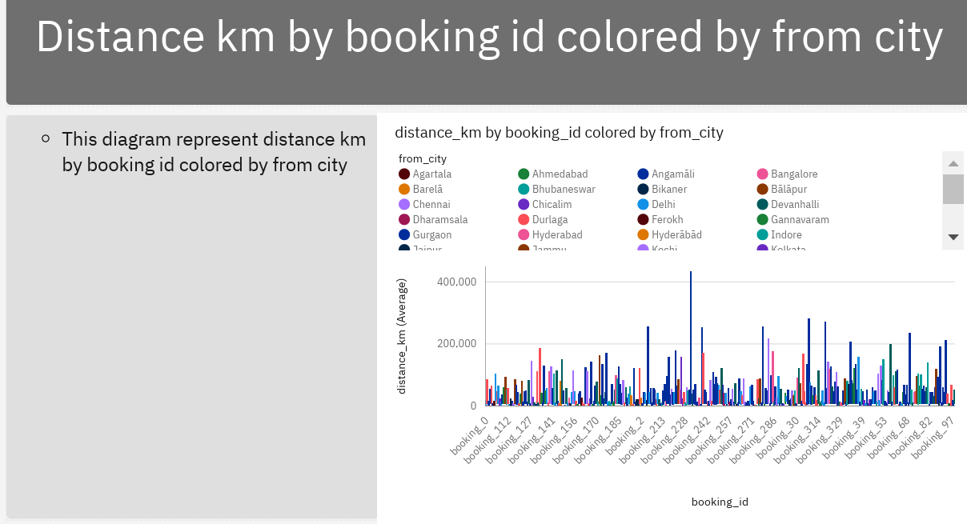
STORY

Slide 13
Dashboard link
https://us3.ca.analytics.ibm.com/bi/?perspective=dashboard&pathRef=.my_folders%2FBookings%2Bdashboard&action=view&mode=dashboard&subView=model0000018b2d277c8b_00000000

Slide 14
Story link
https://us3.ca.analytics.ibm.com/bi/?perspective=story&pathRef=.my_folders%2FBooking%2Bstore&action=view&sceneId=-1&sceneTime=0

Slide 15
Report link
https://us3.ca.analytics.ibm.com/bi/?pathRef=.my_folders%2FNew%2Breport%2Bbookings&action=run&format=HTML&prompt=false

Slide 16
Student Details
Name:T.chaitanya
Email:chaithuthupakula449@gmail.com
Id:bscmscs2021061
Halticket:0322022143
Name: M.soniya
Email: sonysathish524@gmail.com
Halticket :0322022117
Id:Bscmscs2021046

Slide 17
Student Details
Name:Bharath
Email:Babibharath8919@gmail.com
Hall ticket:0322022116
Id:Bscmscs2021052
Name:Hemanth Kumar
Email.Nethibottuhemanth@gmail.com
Hall ticket:0322022123
Roll num:Bscmscs 2021047

Slide 18
Student Details
Name: Basireddy Naveen Kumar Reddy
Hall ticket:0322022076
I'd card : BscMscs2021062
E-mail: srinaveenreddy0816@gmail.com
Name:k.gurucharan
Email:guruguruchaean99@gmail.com
Halticket :0322022104
Id:bscmscs2021067

Slide 19
Conclusion
Expedia, Booking.com, and Kayak are all leading travel aggregators with their unique features and strengths.
The choice of aggregator depends on the specific needs and preferences of the user, such as the type of travel services required and the importance of user reviews.
It is advisable for users to explore these leading aggregators and compare their offerings to find the best fit for their travel needs.
Notes:
Image source: https://limbd.org/aggregators-types-of-aggregators-advantages-of-aggregators-disadvantages-of-aggregators-importance-of-aggregators/

Slide 20
References
Expedia. (n.d.). Retrieved from https://www.expedia.com/
Booking.com. (n.d.). Retrieved from https://www.booking.com/
Kayak. (n.d.). Retrieved from https://www.kayak.com/

Slide 21


